Slide 1
Notebooks for python and R
Chris Baldassano
PSYC GR6130, Fall 2019

Slide 2
Jupyter Notebooks
Features for academic research:
Interactive code execution and visualization
Allows investigation of datasets
Can build and test an analysis pipeline piece-by-piece
Can intersperse code with text and equations
Can explain the purpose of the analysis for your future self or for sharing with others
Can use multiple languages, including python and R
Can share static or live versions easily online

Slide 3
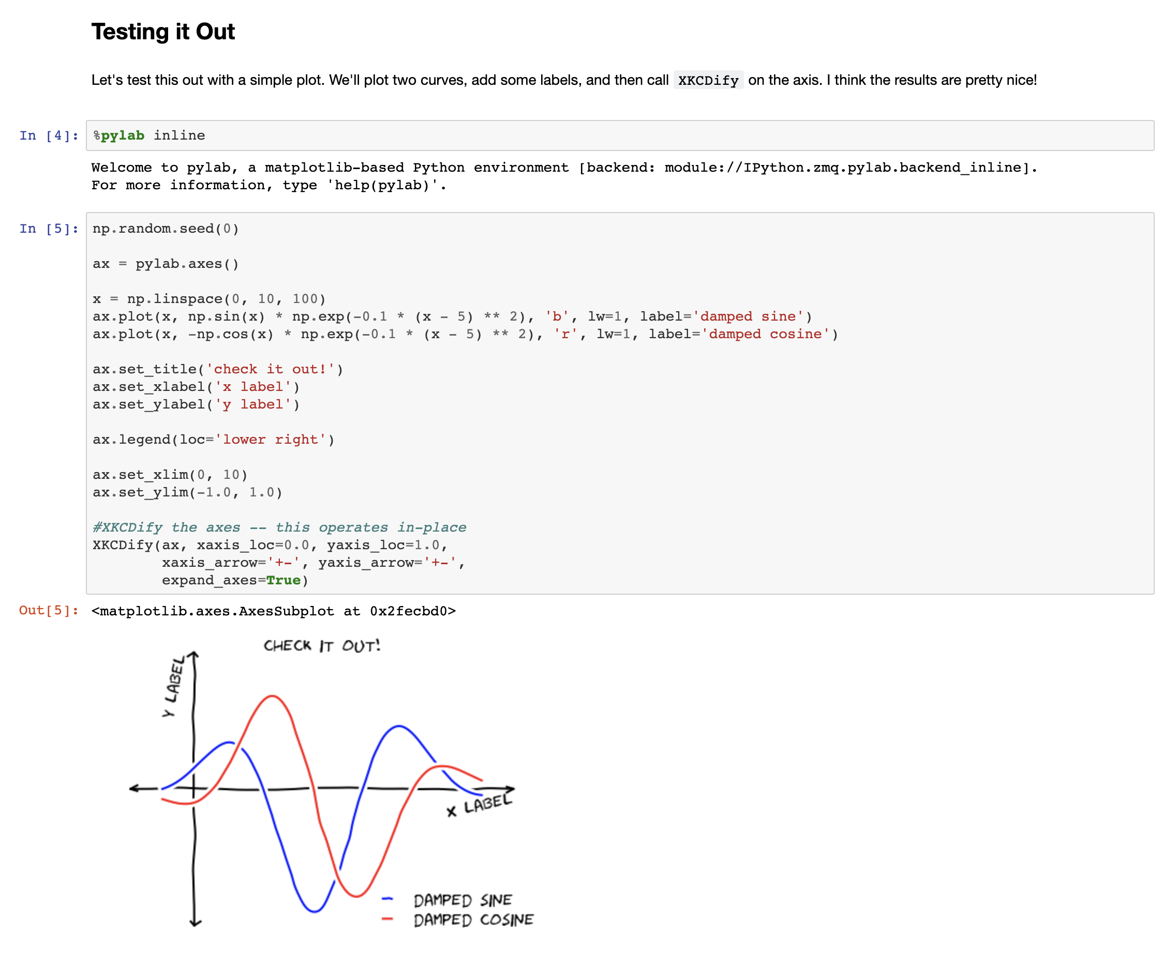

Slide 4
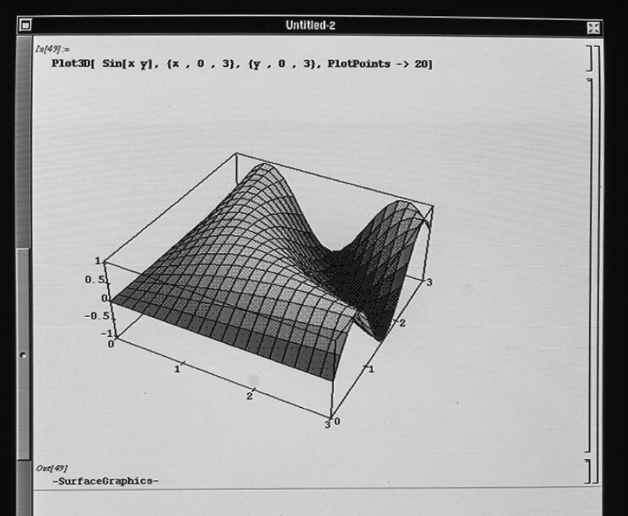
History
1988 – Mathematica notebooks

Slide 5
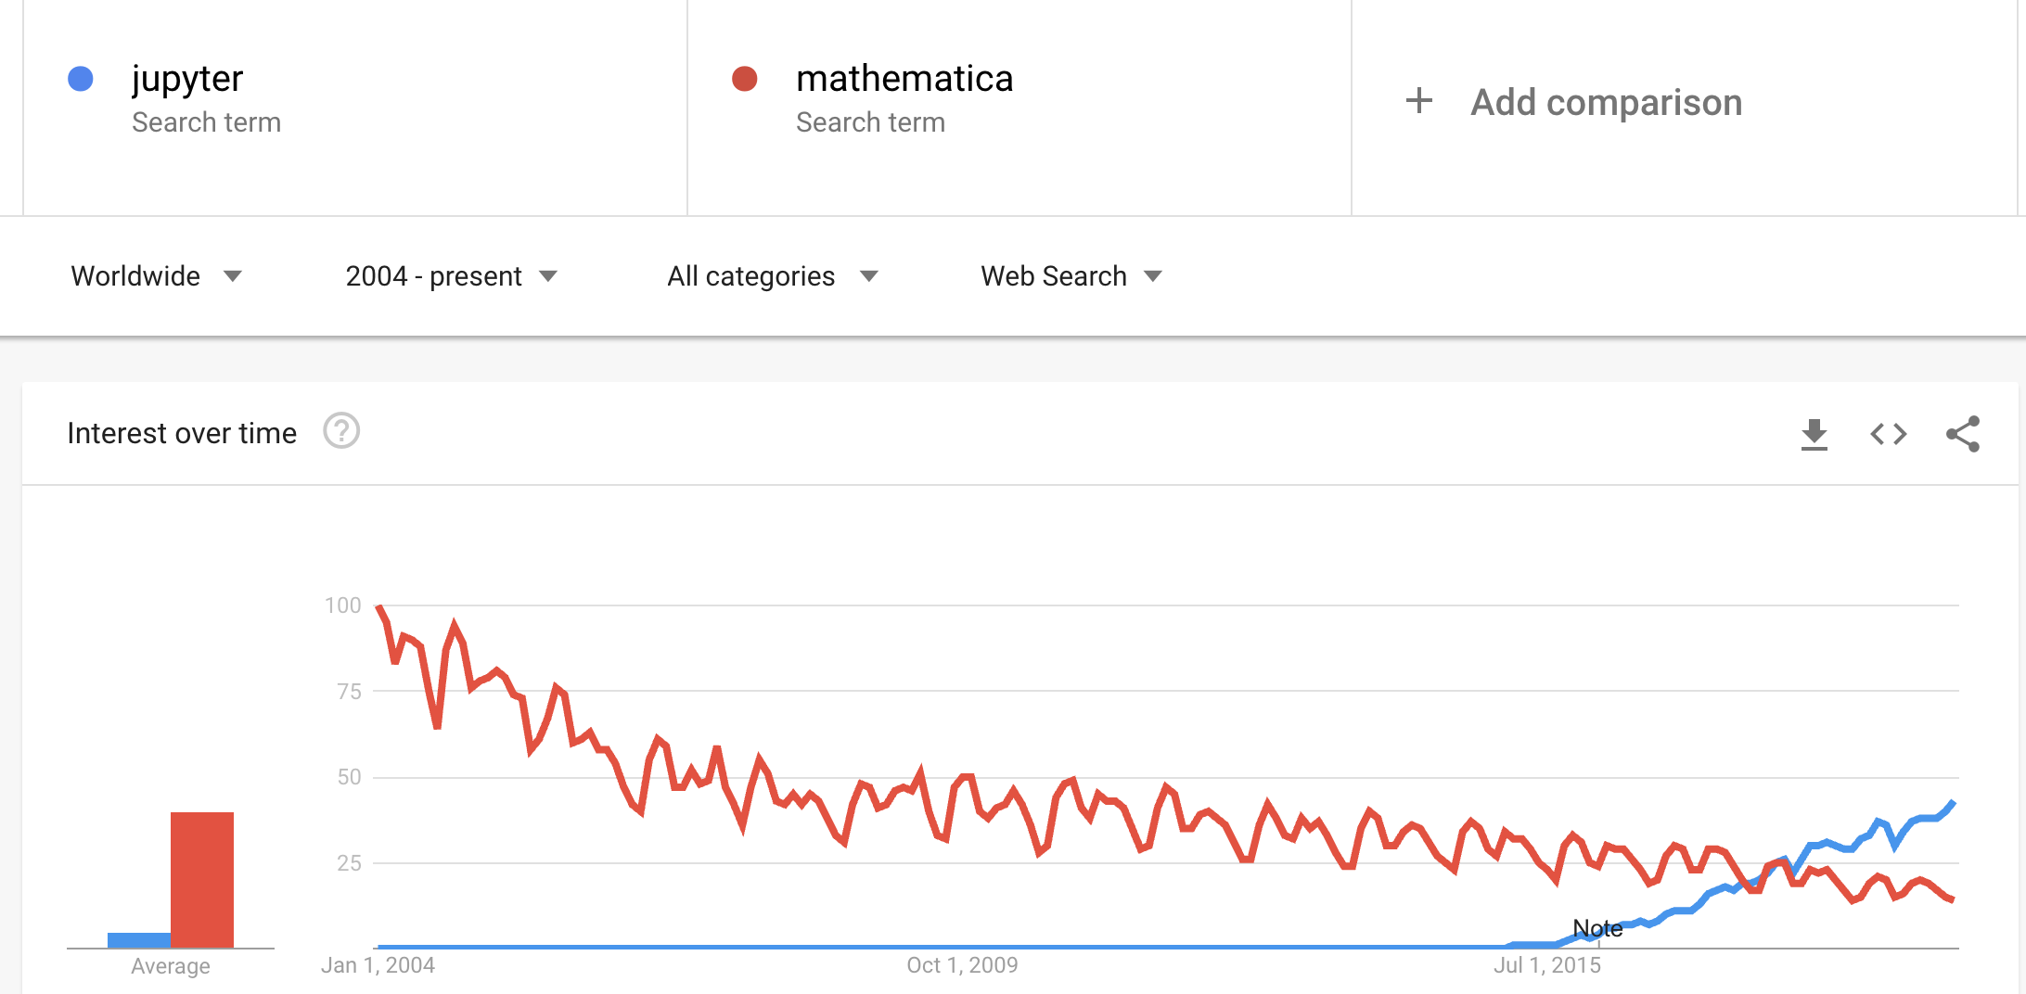
History
1988 – Mathematica notebooks
2001 – Fernando Pérez (Physics grad student) starts python notebooks
2014 – Notebooks support multiple multiple kernels (R, Julia, …)

Slide 6
Live Demo

Slide 7
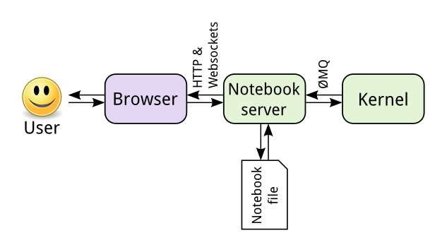
Jupyter architecture

Slide 8
Ipynb Files
The .ipynb notebook files are actually just plain-text JSON files
There are fields for the content of each cell, its metadata, and its outputs
Images base64-encoded into a text string

Slide 9
Ipynb Files
{"cells": [
{"cell_type": "code", "execution_count": 1, "metadata": {}, "outputs": [],
"source": ["import numpy as np\n",]},
{"cell_type": "markdown", "metadata": {},
"source": ["First we can train a linear nu-SVM."]},
{"cell_type": "code", "execution_count": 2, "metadata": {},
"outputs": [ {"name": "stdout", "output_type": "stream", "text": ["Linear SVM Accuracy: 0.712\n"]}],
"source": ["clf = NuSVC(kernel='linear')\n",
"clf.fit(train, labels)\n",
"lin_conf = confusion_matrix(labels, clf.predict(test))\n",
"print('Linear SVM Accuracy: ', accuracy_score(labels, pred_labels))"]}
]}

Slide 10
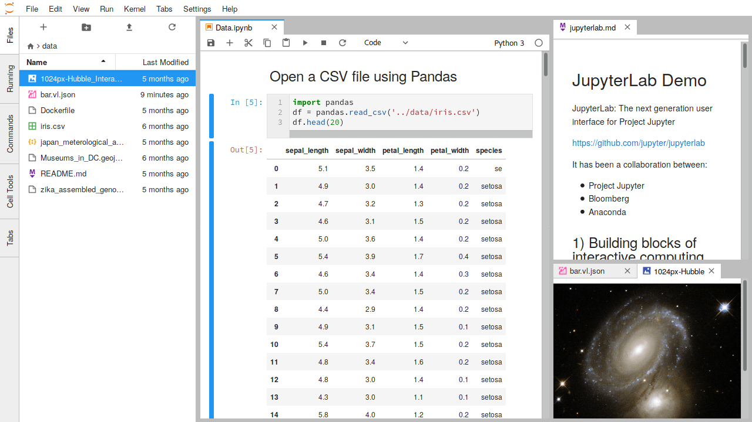
Jupyterlab

Slide 11
IPython Magic
Python Jupyter notebooks generally use the IPython kernel, which is an extension of python
One major difference: “magic commands”
“Line magics” – single-line commands, starting with %
“Cell magics” – change behavior of a whole cell, starting with %%
Some favorites:
%matplotlib inline – use this anytime you use matplotlib, to get plots to show up
%who_ls – list variables currently defined
%timeit, or %%time – measures how long a line or cell takes to run
%run – execute an external .py script
%history – print history of recent commands
%pip – install a new package, without leaving the notebook

Slide 12
Markdown
Allows plain text documents to be rendered with formatting
Design goal: remain as readable as possible (unlike HTML)
Not specific to Jupyter notebooks – this syntax will show up in multiple tools throughout the course

Slide 13
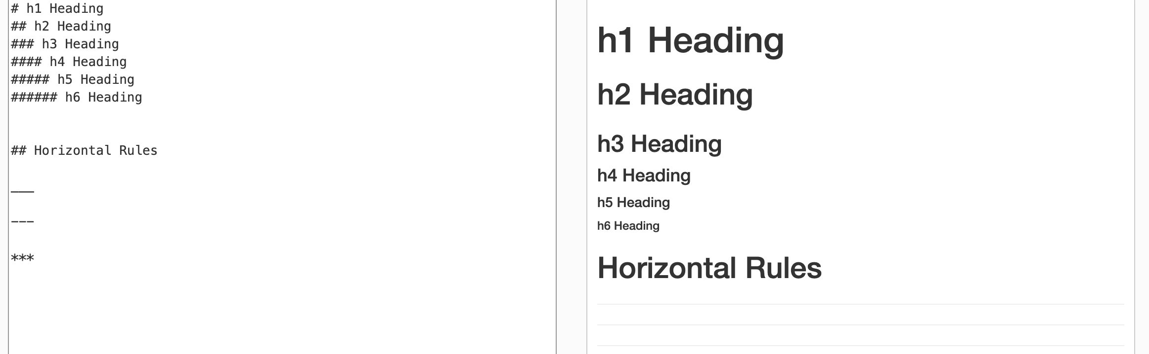
Markdown
Markdown
Rendered HTML

Slide 14
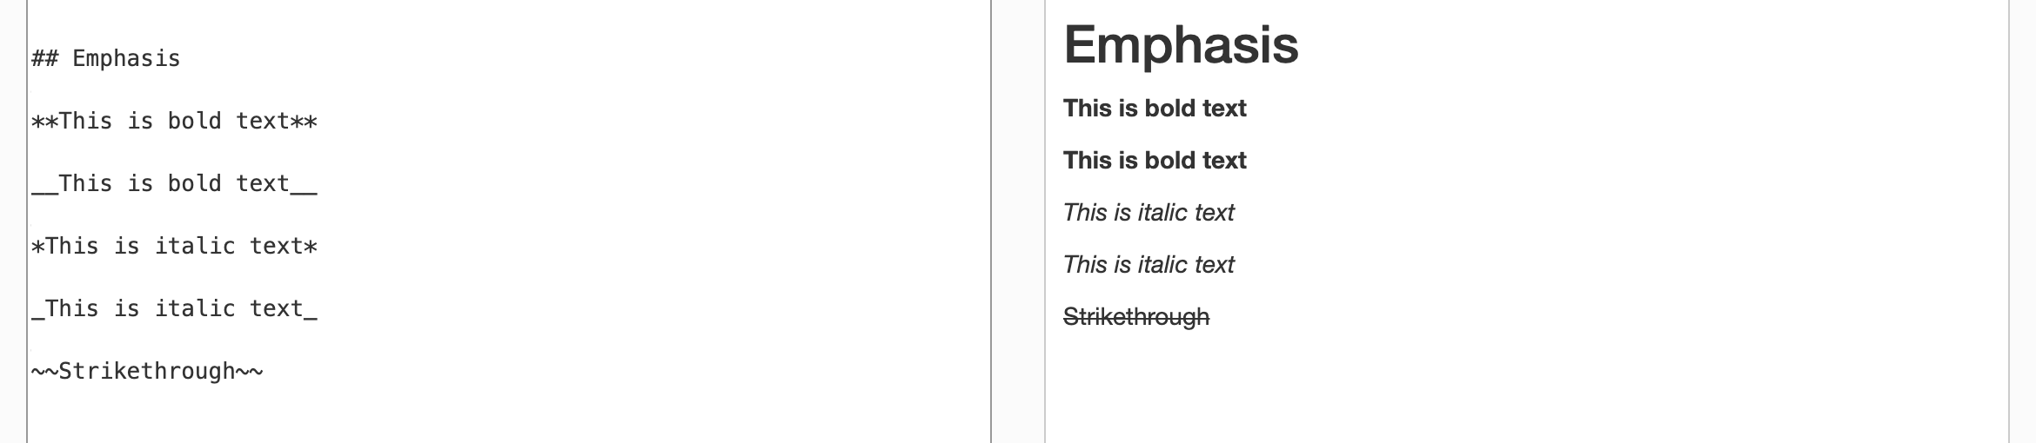
Markdown
Markdown
Rendered HTML

Slide 15
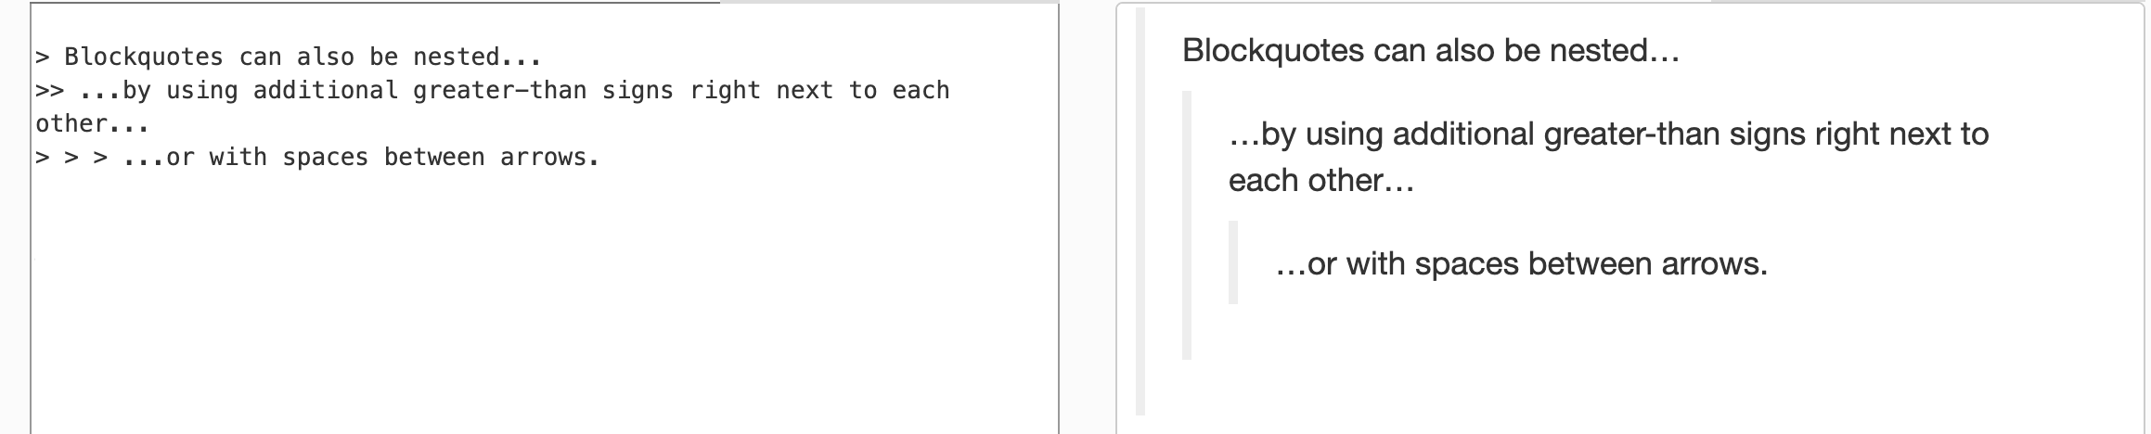
Markdown
Markdown
Rendered HTML

Slide 16
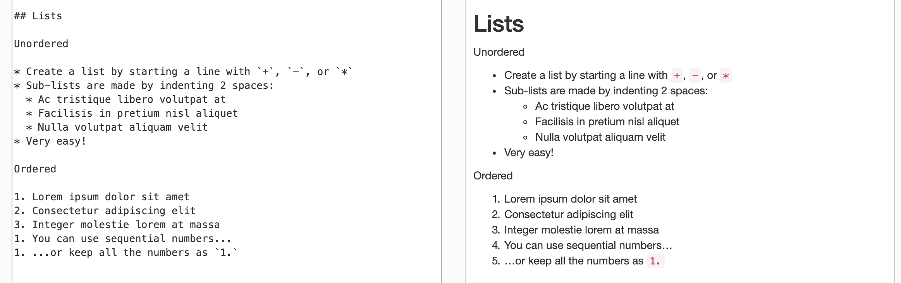
Markdown
Markdown
Rendered HTML

Slide 17
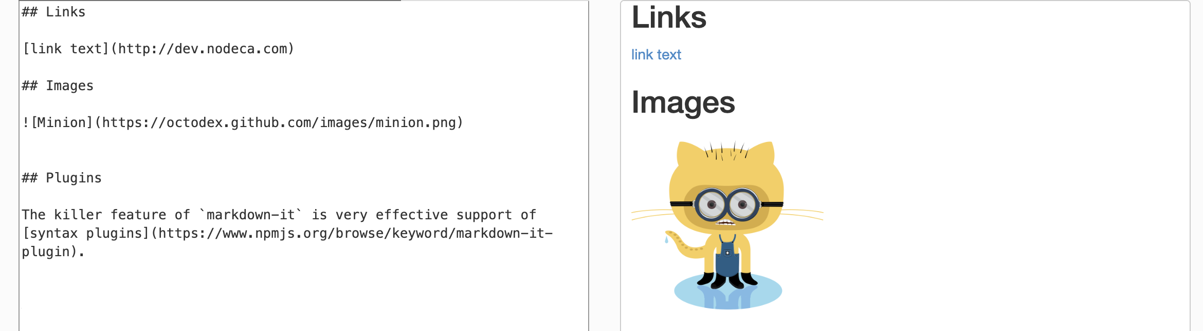
Markdown
Markdown
Rendered HTML

Slide 18
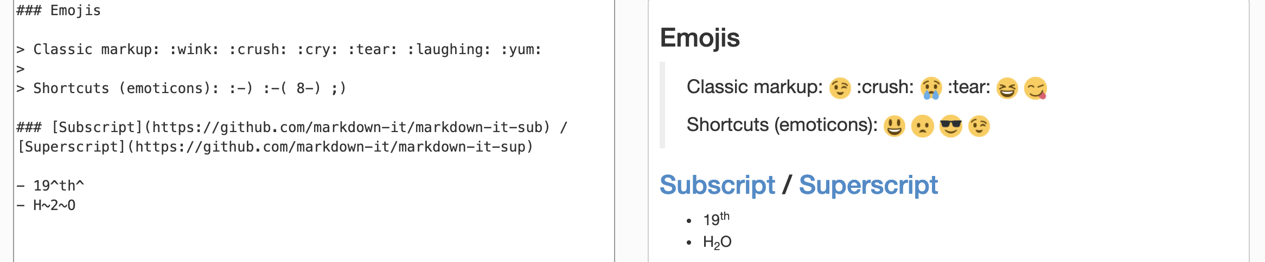
Markdown
Markdown
Rendered HTML

Slide 19
Sharing notebooks
Simply share ipynb files – requires python setup with all libraries
https://nbviewer.jupyter.org/ – renders any python notebook in a public repository as static HTML
Can also run nbviewer command locally to convert notebook to an HTML/pdf file
https://colab.research.google.com/ – opens any public notebook in an interactive environment (12 hour time limit)
https://mybinder.org - opens notebook in pre-specified environment (requires requirements.txt or environment.yml)
CodeOcean – create an interactive shareable environment
More details later in the semester

Slide 20
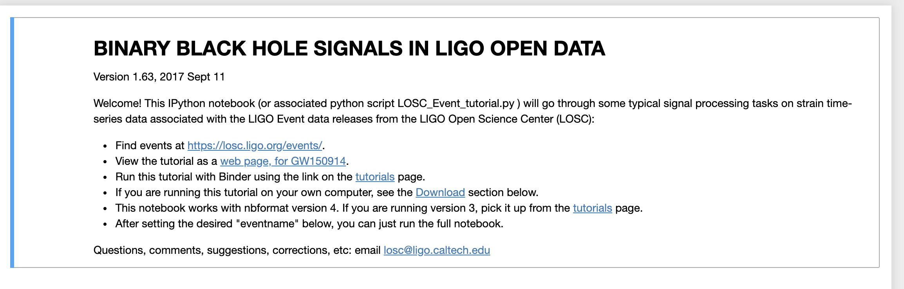
Detection of Gravitational Waves
https://mybinder.org/v2/gh/losc-tutorial/LOSC_Event_tutorial/master

Slide 22
Lab Instructions
Open assignment: https://classroom.github.com/a/Mdt0U6Os
Click “Clone or Download” to get repository URL
In terminal, type git clone [URL] to get a local copy
Start Jupyter Lab through Anaconda Navigator, open Exercises.ipynb
When done, save Exercises.ipynb. In a terminal in the same folder:
git add Exercises.ipynb
git commit –m "Complete”
git push
[We will discuss what these commands mean next class!]

